Slide 1

CERTIFICATE III IN AUTOMOTIVE REPAIR & MAINTENANCE
SUBJECT: VEHICLE MAINTENACE AND REPAIR
By Ibrahim siraj
Maldives polytechnic

Slide 2
AUTOMOTIVE ENGINE PRACTICE
By Ibrahim siraj
Maldives polytechnic

Slide 3
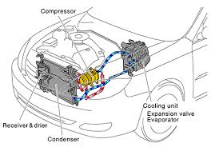
VEHICLE MAINTENACE AND REPAIR
Chapter 15 Inspection and Service Auto Air-condition system components
Introduction
Automotive air conditioning (A/C) systems, part of a vehicle's Heating, Ventilation, and Air Conditioning (HVAC) system, operate on the principle of thermodynamics, moving heat from inside the car to the outside using a refrigerant
By Ibrahim siraj
Maldives polytechnic

Slide 4
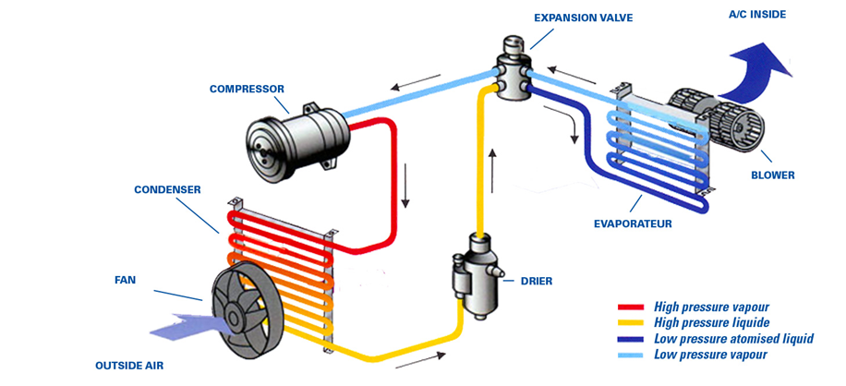
VEHICLE MAINTENACE AND REPAIR
Chapter 15 Inspection and Service Auto Air-condition system components
Core Principles
The primary functions of the system are cooling, dehumidifying, and circulating the air within the vehicle cabin. The process involves a continuous cycle where the refrigerant changes between liquid and gas states at different pressures and temperatures.
By Ibrahim siraj
Maldives polytechnic

Slide 5
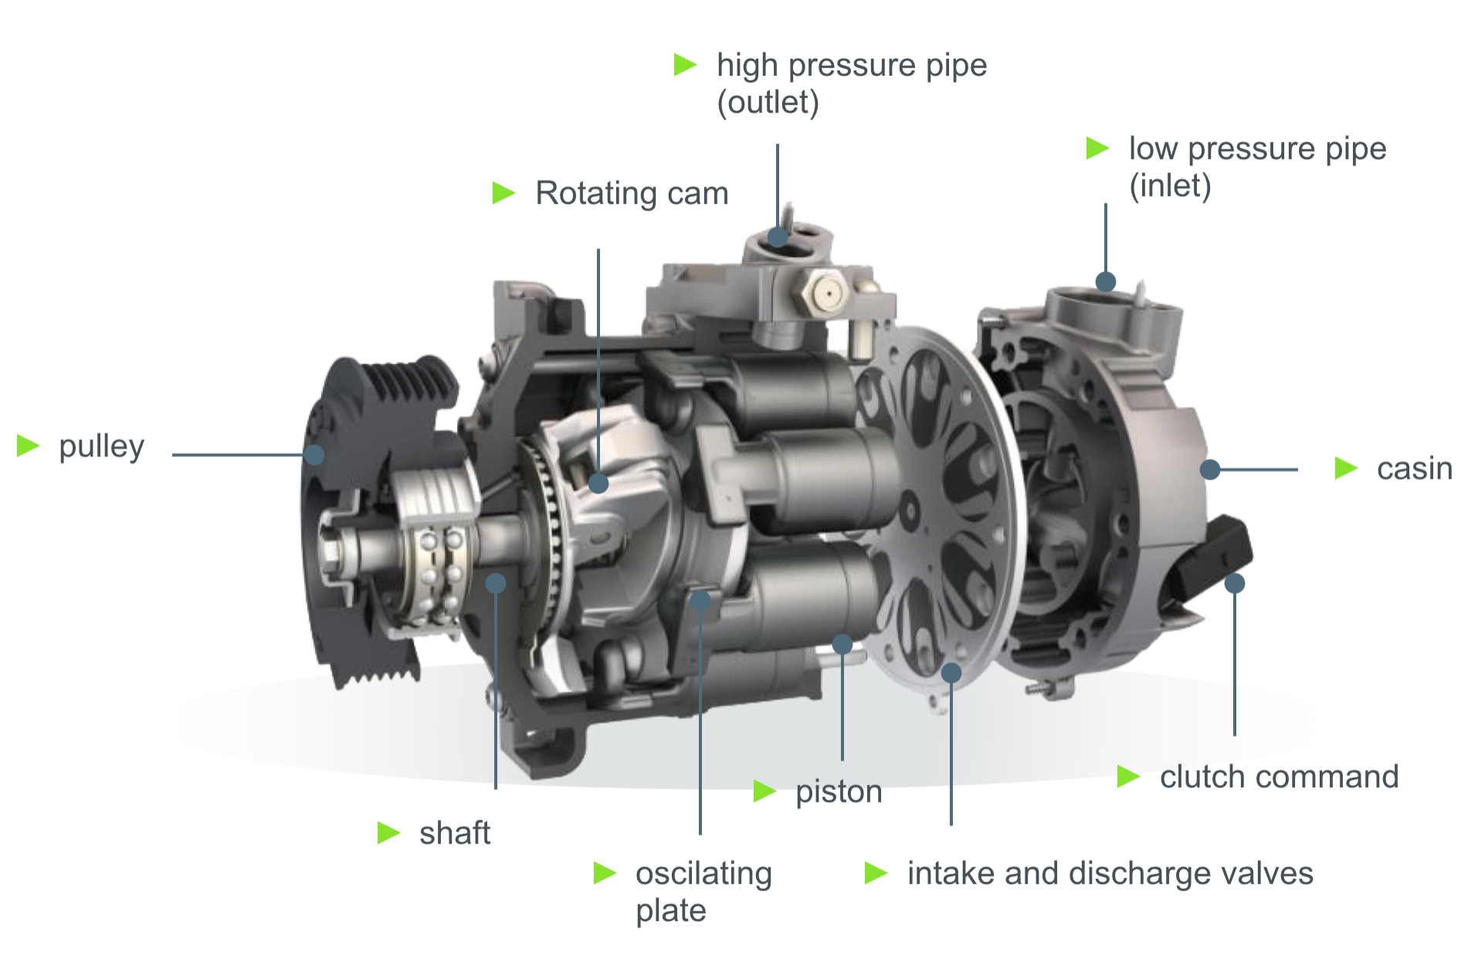
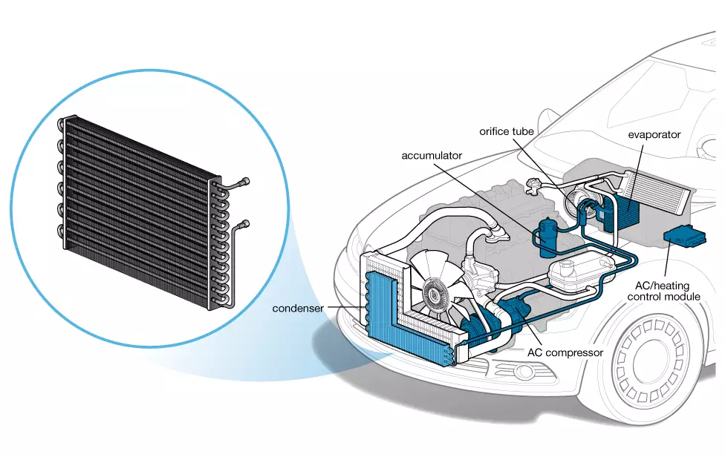
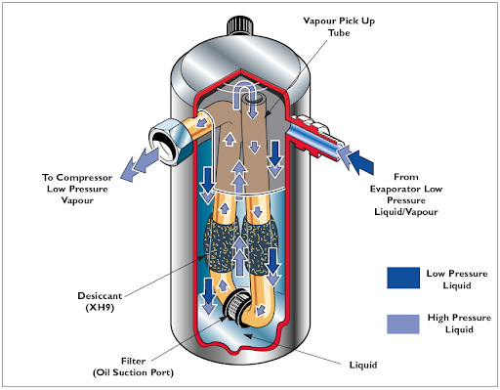
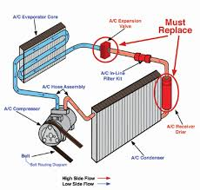
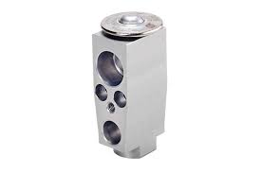
VEHICLE MAINTENACE AND REPAIR
Chapter 15 Inspection and Service Auto Air-condition system components
Main Components and the Refrigeration Cycle
Compressor
Condenser
Receiver/Dryer or Accumulator
Expansion Valve or Orifice Tube
By Ibrahim siraj
Maldives polytechnic

Slide 6
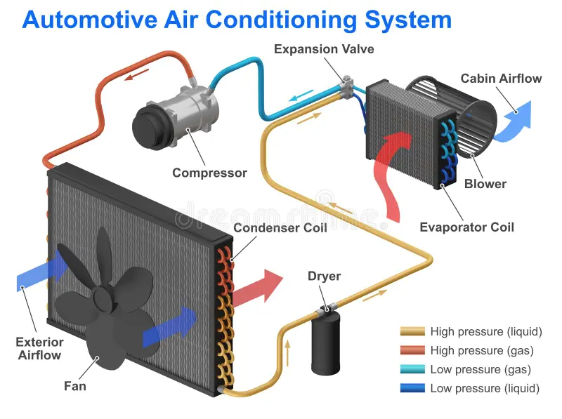
VEHICLE MAINTENACE AND REPAIR
Chapter 15 Inspection and Service Auto Air-condition system components
Compressor
Known as the "heart" of the system, this belt-driven pump (or electric in EVs) compresses the low-pressure, low-temperature refrigerant gas into a high-pressure, high-temperature gas.
By Ibrahim siraj
Maldives polytechnic

Slide 7
VEHICLE MAINTENACE AND REPAIR
Chapter 15 Inspection and Service Auto Air-condition system components
Compressor
Common Types of Car AC Compressors
Scroll Compressor: Uses two spiral scrolls (one fixed, one orbiting) to compress refrigerant, offering high efficiency, quiet operation, and fewer moving parts.
Reciprocating Piston Compressor: Uses a piston-cylinder mechanism, often a swash or wobble plate, to pump refrigerant, recognized for robustness.
Rotary Vane Compressor: Employs rotating vanes inside a cylinder to create pressure, known for being smooth, compact, and often used in high-power applications.
Variable Displacement Compressor (VDC): These adjust the internal stroke or swash plate angle to vary output based on load, frequently without a clutch, which reduces drag and improves fuel efficiency.
Fixed Displacement Compressor: Operates at a constant displacement when engaged via a clutch, meaning it constantly cycles on and off to maintain temperature.
Electric Scroll Compressor: Designed for electric/hybrid vehicles, using high-voltage power instead of an engine belt to run independent of engine speed
By Ibrahim siraj
Maldives polytechnic

Slide 8
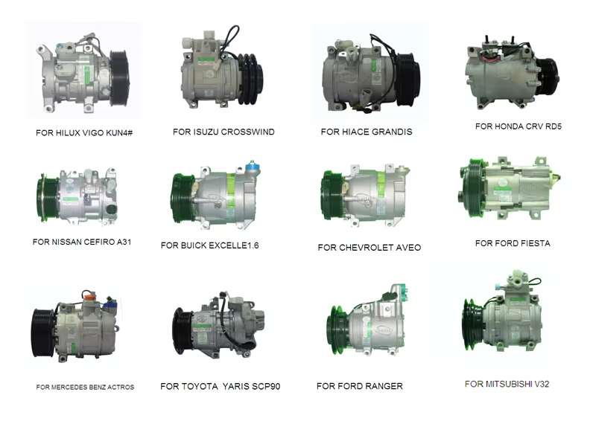
VEHICLE MAINTENACE AND REPAIR
Chapter 15 Inspection and Service Auto Air-condition system components
Compressor
Common Types of Car AC Compressors
By Ibrahim siraj
Maldives polytechnic

Slide 9
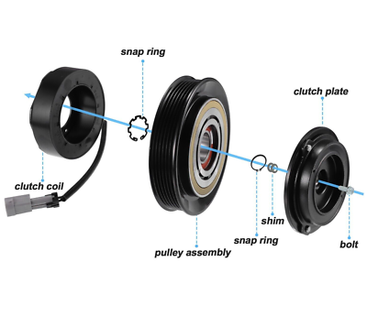
VEHICLE MAINTENACE AND REPAIR
Chapter 15 Inspection and Service Auto Air-condition system components
Compressor
Compressor clutch
An AC compressor clutch allows the air conditioning compressor to engage and disengage from the engine's drive belt, regulating refrigerant circulation. It consists of a pulley, coil, and pressure plate, which can fail due to worn bearings, broken coils, or improper air gap. Symptoms include loud clicking/squealing, AC blowing hot air, or a burning smell.
Failure Symptoms
Noisy Operation: Squealing or grinding noises when the AC is on, often caused by a bad pulley bearing.
AC Blowing Hot: The clutch fails to engage, so the compressor does not run.
Visible Damage: The rubber center of the clutch may disintegrate.
Belt Issues: A seized compressor clutch can cause the serpentine belt to burn or snap.
By Ibrahim siraj
Maldives polytechnic

Slide 10
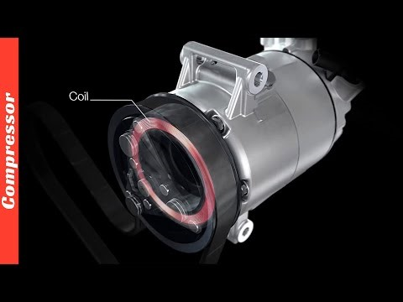
VEHICLE MAINTENACE AND REPAIR
Chapter 15 Inspection and Service Auto Air-condition system components
Compressor
Common Types of Car AC Compressors
By Ibrahim siraj
Maldives polytechnic

Slide 11
VEHICLE MAINTENACE AND REPAIR
Chapter 15 Inspection and Service Auto Air-condition system components
Condenser
The hot, high-pressure gas flows to the condenser (located outside the cabin, often near the radiator), which dissipates heat to the outside air, causing the refrigerant to condense into a high-pressure liquid
By Ibrahim siraj
Maldives polytechnic

Slide 12
VEHICLE MAINTENACE AND REPAIR
Chapter 15 Inspection and Service Auto Air-condition system components
Receiver/ Dryer or Accumulator
This component stores the liquid refrigerant and removes moisture and debris from the system to prevent damage and maintain efficiency. An accumulator is used in systems with an orifice tube, is located on the low-pressure side, and primarily acts as a safety device to ensure only vapor enters the
By Ibrahim siraj
Maldives polytechnic

Slide 13
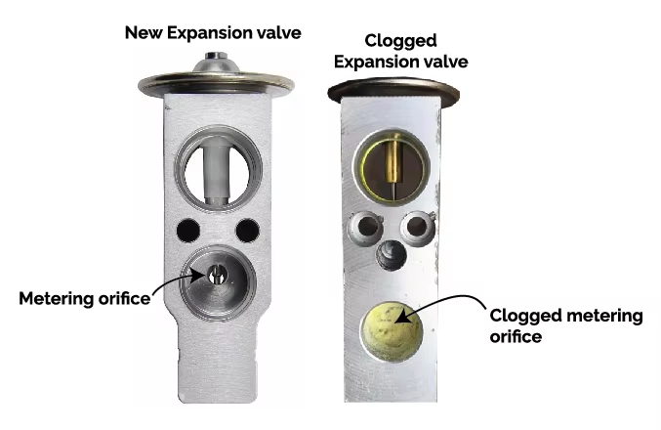

VEHICLE MAINTENACE AND REPAIR
Chapter 15 Inspection and Service Auto Air-condition system components
Expansion Vale or Orifice Tube
This device regulates the flow of the high-pressure liquid refrigerant into the evaporator. As the refrigerant passes through a small opening, its pressure drops rapidly, which causes its temperature to decrease significantly, turning it into a cool mixture of liquid and gas
By Ibrahim siraj
Maldives polytechnic

Slide 14
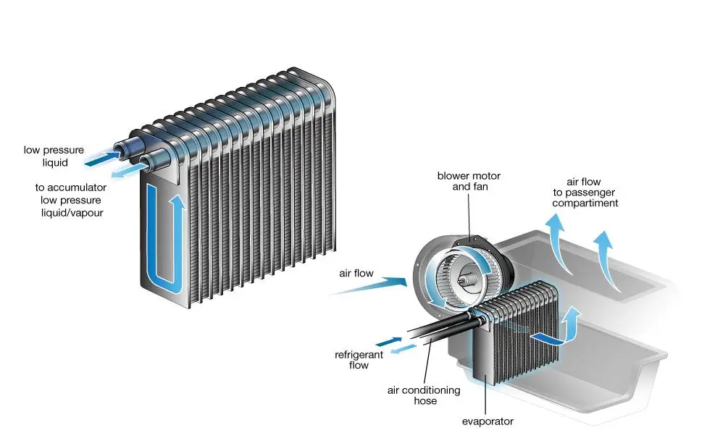
VEHICLE MAINTENACE AND REPAIR
Chapter 15 Inspection and Service Auto Air-condition system components
Evaporator
Located inside the vehicle's cabin, the low-pressure, low-temperature refrigerant mixture absorbs heat from the cabin air passing over its coils. This heat absorption causes the refrigerant to vaporize into a gas, cooling the air. A secondary benefit is that moisture from the warm air condenses on the cold evaporator coils, dehumidifying the air.
By Ibrahim siraj
Maldives polytechnic

Slide 15
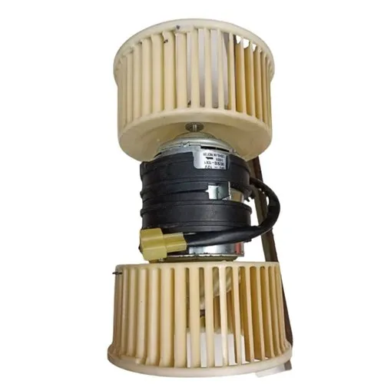
VEHICLE MAINTENACE AND REPAIR
Chapter 15 Inspection and Service Auto Air-condition system components
Blower Fan
The fan circulates the now-cooled, dehumidified air into the cabin through the air vents
The refrigerant gas then returns to the compressor, and the cycle repeats as long as the system is running
By Ibrahim siraj
Maldives polytechnic

Slide 16
VEHICLE MAINTENACE AND REPAIR
Chapter 15 Inspection and Service Auto Air-condition system components
Common AC faults
Refrigerant leaks, a failing compressor, a clogged condenser or cabin air filter, and various electrical problems
1. Warm or No Cold Air
This is the most common symptom of an AC problem and usually points to one of a few key issues:
Low Refrigerant Levels: The most frequent cause of an AC not blowing cold air is insufficient refrigerant, which is typically due to a leak in the sealed system. Leaks can occur in hoses, O-rings, or other components due to age, wear, or corrosion.
Signs: Hissing sounds, visible oily residue (sometimes green) around components, and progressively warmer air from the vents.
By Ibrahim siraj
Maldives polytechnic

Slide 17
VEHICLE MAINTENACE AND REPAIR
Chapter 15 Inspection and Service Auto Air-condition system components
Common AC faults
Refrigerant leaks, a failing compressor, a clogged condenser or cabin air filter, and various electrical problems
Faulty Compressor: The compressor is the heart of the AC system, circulating and compressing the refrigerant. If it fails or its clutch doesn't engage, the entire system stops working.
Signs: No cold air, unusual noises (grinding, squealing, loud clicking) when the AC is on, or a burning smell.
Blocked or Broken Condenser: Located at the front of the vehicle, the condenser releases heat from the refrigerant. It can become clogged with dirt, bugs, and road debris, or be damaged by impacts.
Signs: Weak cooling performance, engine overheating when the AC is running, or visible damage/blockage on the condenser fins
By Ibrahim siraj
Maldives polytechnic

Slide 18
VEHICLE MAINTENACE AND REPAIR
Chapter 15 Inspection and Service Auto Air-condition system components
Common AC faults
Refrigerant leaks, a failing compressor, a clogged condenser or cabin air filter, and various electrical problems
2. Weak Airflow
If the air coming from the vents is not as strong as it should be, even on the highest setting, the problem may not be with the cooling itself:
Clogged Cabin Air Filter: A dirty, blocked, or deteriorated cabin air filter can significantly restrict airflow into the cabin, leading to poor circulation and a musty odor.
Failing Blower Motor: The blower motor is responsible for pushing the air through the vents. A problem with the motor, resistor, or a blown fuse can cause weak or inconsistent airflow.
Blocked Vents or Ducts: Debris or physical damage to the ductwork can also impede air delivery.
By Ibrahim siraj
Maldives polytechnic

Slide 19
VEHICLE MAINTENACE AND REPAIR
Chapter 15 Inspection and Service Auto Air-condition system components
Common AC faults
Refrigerant leaks, a failing compressor, a clogged condenser or cabin air filter, and various electrical problems
3. Unusual Noises or Smells
Strange operational feedback often indicates a specific component is struggling:
Musty/Moldy Smells: Accumulation of moisture in the evaporator coil can lead to the growth of bacteria or mold.
Solution: Professional cleaning of the system with antibacterial agents or replacement of the cabin air filter typically solves this issue
.
Hissing or Bubbling Noises: These sounds usually indicate a refrigerant leak or air in the system.
Grinding or Squealing Noises: Often points to a problem with the compressor clutch or the compressor's internal parts
By Ibrahim siraj
Maldives polytechnic

Slide 20
VEHICLE MAINTENACE AND REPAIR
Chapter 15 Inspection and Service Auto Air-condition system components
Common AC faults
Refrigerant leaks, a failing compressor, a clogged condenser or cabin air filter, and various electrical problems
4. Electrical Issues
Modern car AC systems rely on complex electrical components, and even minor faults can disable the system.
Blown Fuses or Relays: A simple blown fuse can prevent the blower motor or compressor clutch from engaging.
Faulty Sensors or Wiring: Problems with temperature sensors, pressure switches, or damaged wiring can cause the system to malfunction or run inconsistently.
By Ibrahim siraj
Maldives polytechnic

Slide 21
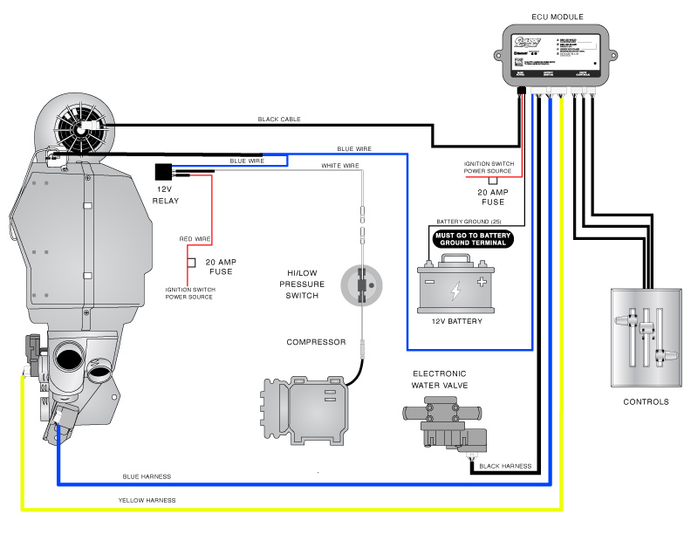
VEHICLE MAINTENACE AND REPAIR
Chapter 15 Inspection and Service Auto Air-condition system components
Common AC faults
Refrigerant leaks, a failing compressor, a clogged condenser or cabin air filter, and various electrical problems
By Ibrahim siraj
Maldives polytechnic

Slide 22
VEHICLE MAINTENACE AND REPAIR
Chapter 15 Inspection and Service Auto Air-condition system components
Visual Inspection
Before using specialized tools, a basic inspection can sometimes reveal obvious leaks
Look for Oily Residue: Refrigerant oil often leaks with the gas and can leave an oily, sometimes green or yellow, residue around AC components, hoses, fittings, and the compressor. The condenser (located in front of your radiator) is a common place for damage from road debris.
Listen for Hissing: With the engine off, a hissing or bubbling sound may be audible near a large leak as pressurized refrigerant escapes.
Check for Physical Damage: Look for cracks in hoses, loose connections, or visible damage to the condenser or other metal lines.
Sweet Smell: A sweet, chemical odor (sometimes compared to nail polish remover) can indicate an evaporator leak inside the cabin.
By Ibrahim siraj
Maldives polytechnic

Slide 23
VEHICLE MAINTENACE AND REPAIR
Chapter 15 Inspection and Service Auto Air-condition system components
2. UV Dye Detection
This is a popular and effective method for pinpointing the exact location of a leak.
Add Dye: A small amount of special UV fluorescent dye (compatible with your car's refrigerant type, such as R134a) is injected into the low-pressure AC service port. You can buy UV dye kits at most auto parts stores.
Circulate the Dye: Run the car's AC system on maximum for 15-30 minutes to allow the dye to circulate with the refrigerant and oil throughout the system.
Inspect with a UV Light: In a dimly lit area, use a UV (black) light and yellow safety glasses to scan all AC components. The escaping dye will glow brightly yellow or green at the leak source.
By Ibrahim siraj
Maldives polytechnic

Slide 24
VEHICLE MAINTENACE AND REPAIR
Chapter 15 Inspection and Service Auto Air-condition system components
3. Electronic Leak Detection (Sniffer)
An electronic leak detector, or "sniffer," is a highly sensitive tool that detects the presence of halogen-based refrigerant gases
Scan the System: With the AC system pressurized (engine can be off but pressure maintained), move the detector probe slowly along the AC lines, connections, compressor, and condenser.
Listen for the Alarm: The device will emit an audible alarm or show a reading increase when it passes over escaping refrigerant, even tiny leaks that might not show with dye.
Check Hard-to-Reach Areas: This method is particularly useful for finding leaks in difficult areas like the evaporator core, which is inside the dashboard
By Ibrahim siraj
Maldives polytechnic

Slide 25
VEHICLE MAINTENACE AND REPAIR
Chapter 15 Inspection and Service Auto Air-condition system components
4. Soapy Water (Bubble) Test
This is a simple, inexpensive method for easily accessible components, though less effective for very small leaks.
Mix a Solution: Prepare a spray bottle with a solution of water and a few drops of dish soap.
Spray Potential Leaks: Spray the solution onto suspected leak points (connections, valves, hoses).
Look for Bubbles: The escaping gas will create large bubbles at the leak location.
By Ibrahim siraj
Maldives polytechnic

Slide 26
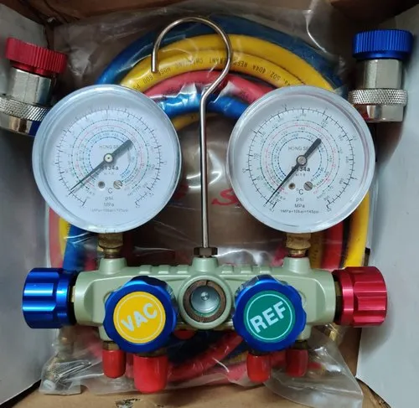
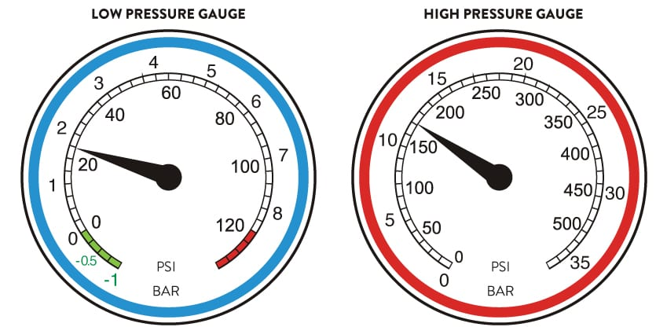
VEHICLE MAINTENACE AND REPAIR
Chapter 15 Inspection and Service Auto Air-condition system components
5. Nitrogen Pressure Test
This is a professional method used when the system is completely empty of refrigerant and cannot hold a charge. The system is pressurized with dry nitrogen, and a technician listens for hissing or uses a bubble solution to find the leak
By Ibrahim siraj
Maldives polytechnic

Slide 27
THANK YOU

